Slide 1

Jashore University of Science and Technology
Department of Computer Science and Engineering
Course Code: CSE 1202
Course Title: Data Structures
Project Proposal of Group-1
Submitted by Group - 1 Student ID: (200101 - 200110) 1st year 2nd semester Department of Computer Science and Engineering Jashore University of Science and Technology | Submitted to Dr. Md. Alam Hossain Associate Professor Department of Computer Science and Engineering Jashore University of Science and Technology
Date of Submission: 03.12.2022

Slide 2
Project Proposal for
Password’s Strength Check
By Group-1

Slide 3
Name | ID
Mamun-Or-Rashid | 200101
Md. Rafid Ahmmed | 200102
Md. Saniul Basir Saz | 200103
Nazmus Sakib Sibly | 200104
Abrar Hossain | 200105
Md. Mahmudul Amin Shakil | 200106
Abdulla Al Noman | 200107
Mostafa kamal | 200108
Md. Sabbir Hossain Bappy | 200109
Tapu Ghosh | 200110

Slide 4
Project Proposal
1
Introduction
Objective
Methodology

Slide 5
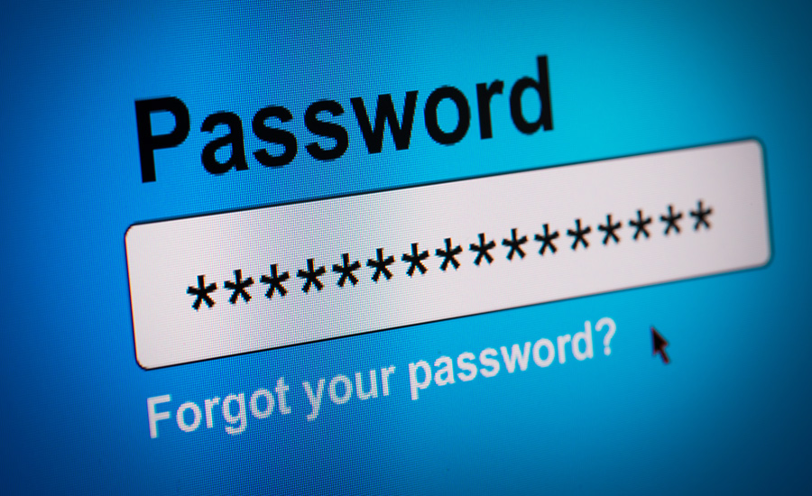
Introduction
2
Q1 : What is a password ?
Passwords provide the first line of defense against unauthorized access to computer and personal information
Ref : Google

Slide 6
Introduction
3
Fields where password is used :
Securing our Bank Accounts
Securing our Social Media Accounts like Facebook, Twitter, Linkedin
Securing our Confidential Data
Securing our PC, Wi-Fi and others
Where there is Security there is Password

Slide 7
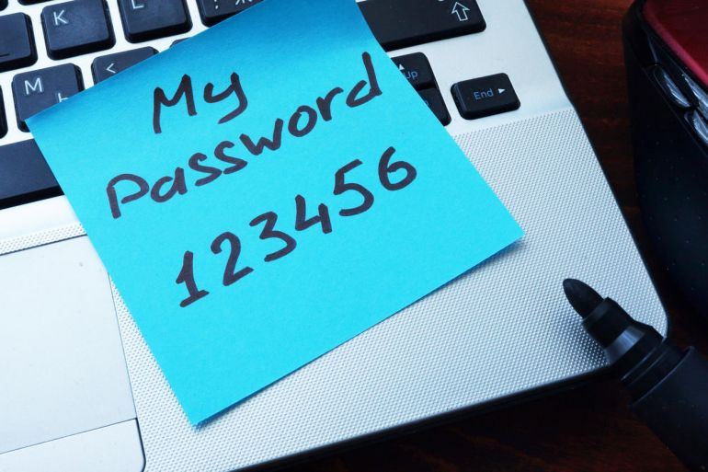
Objective
4
Q2 : What is the objective from this project ?
To make people aware of the importance of sound password and provide with a handy tool that will monitor the quality of the password

Slide 8
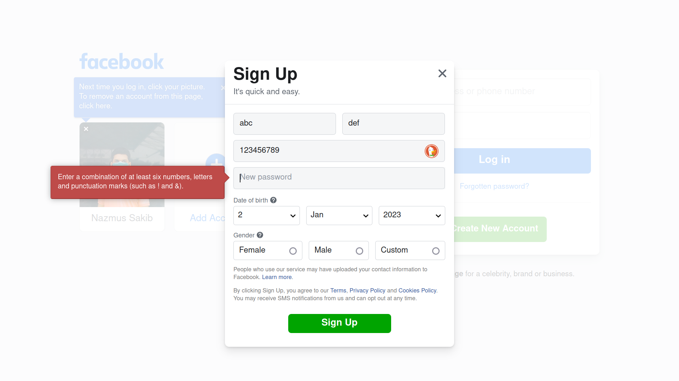
5

Slide 9
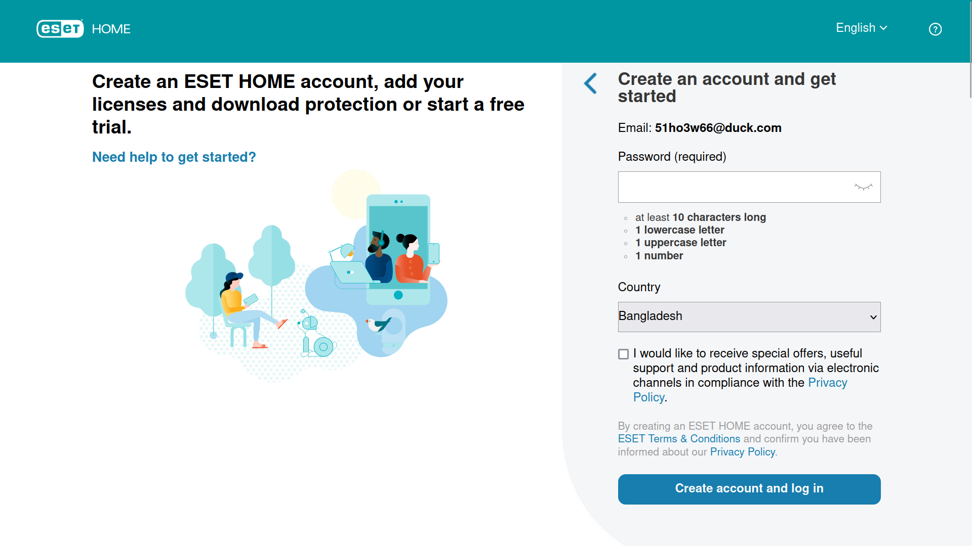
6

Slide 10
Objective
7
World’s top 10 most used password :
1. 123456
2. 123456789
3. 12345
4. qwerty
5. password
6. 12345678
7. 111111
8. 123123
9. 1234567890
10.1234567
Ref: CS50

Slide 11
Methodology
8
Q3 : What is the methodology for determining a strong password ?

Slide 12
Methodology
9
1. The source code is in the C++ language
2. Take the password as string
3. Run various tests on the password
4. Run some sanitizers in the password string
5. Give the verdict regarding the password’s strength
6. Display proper helpful comments to make the password
even more stronger

Slide 13
Methodology
10
Q4: What are the tests that we performed in the password string ?
Test 1: Checking the Length of the Password
Test 2: Checking the Upper Case letters in the Password
Test 3: Checking the Lower Case letters in the Password
Test 4: Checking the Special Characters in the Password
Test 5: Checking the existence of Numbers in the Password

Slide 14
Methodology
11
Q5: What are the sanitizers that we performed in the password string ?
Sanitizer 1: Checking Common “QWERTY” keyboard
combinations in the Password
Sanitizer 2: Checking Contiguous Characters in the Password

Slide 15
Methodology
12
Q6: What are the index that will determine a heathy password ?
Length (7) + Upper Case (4) + Lower Case (2) + Special Characters (4) + Numbers (3) = 20
Common “QWERTY” Combination (-8) / Contiguous Characters (-8) = -8

Slide 16
Methodology
13
Q7: How the judgment will be given ?
If the length is below 6 characters : Extremely Weak
If the length is between 6 to 8 Characters : Weak
If the index value is more than or equal to 15 then : Strong Password
If the index value is more than or equal to 10 : Fair Password
If the index value is more than or equal to 7 : Weak Password
Else the password will be treated as Extremely Weak Password
Priority

Slide 17
Methodology
14
Q8: The criteria for the comments to be shown ?
If the length of the password is small.
If the ASCII Code of the characters entered are contiguous.
If the Password is in the Wordlist file of Kali Linux.
If the characters are common “QWERTY” combination.
If user entered special symbol more than three or equal to three to remind to remember it carefully.
If the user entered space as a password : to remind him about the fact.
If insufficient number of Upper or Lower case letters are entered.
If insufficient number of Alphanumeric characters are used.
To congratulate if a strong password is entered.

Slide 18
Methodology
15
Q9: What are the challenges that we faced during this project ?
Giving a proper index number in total
Counting maximum contiguous characters in the password

Slide 19
Methodology
16
Q10: What are the shortcomings of this project till recent development?
The common passwords that we took are limited.

Slide 20
Methodology
17
Q11: How to resolve the current shortcomings ?
By using an advance file for storing common passwords.

Slide 21
Thank you

